Slide 1
Back to the Basics: Software Done Properly
Brian Korzynski & Hussein Farran

Slide 2
Workshop Agenda
Introductions and Setup
Craftsmanship Lecture
Exercise 1: Craftsmanship
Architecture Lecture
Exercise 2: Architecture
Testing Lecture
Break
Exercise 3: Testing
Refactoring and Reusability Lecture
Exercise 4: Refactoring and Reusability

Slide 3

About Us – Hussein Farran
Cloud Software Developer
Professional developer for 7 years focusing on .NET and cloud.

Slide 4

About Us – Brian Korzynski
Principal Architect
Professional Developer for 14+ years
Windows Forms
Web
Mobile
SQL Optimization
Data Analysis
Mathematics
Big Data
Cloud
Machine Learning
IRON MOUNTAIN

Slide 5
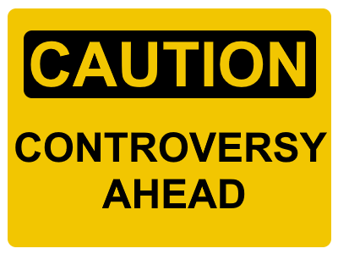
Disclaimer
These are things that have made us successful, and we promise that following them will make you more successful as well.
For those looking to advance your careers, if you want to make the big bucks you must be a top-quality developer.
Some of the things we are going to talk about today may go against your current thinking.

Slide 6
Polls
How many of you have ever had a death march? Or had to work late nights, weekends, or during a vacation.
How many must work with changing business requirements with impossible deadlines? Especially when it drives the death marches.
What if we could tell you could eliminate 98% of those?
Even while making it so you can respond to changes so quickly that you can easily become the rockstar of the team.

Slide 7


Strive for Quality
Vacheron Constantin (Swiss Made)
Completely mechanical, no batteries, circuits, etc.
Oscillates around 25,000 times per hour (7 times/second or 7hz)
Must run 24/7/365 for at least 5 years (before needing maintenance)
39 Ruby Jewel bearings – unconventional material for frictionless bearings but it is the right tool for the job, even though they are expensive

Slide 8

Traditional Learning Path of the Craftsman
In order to make an expensive watch you must first learn:
About the different pieces.
What each piece does and where it fits.
How to make each piece, so that it does its job and looks good.
How to assembly the pieces into a working masterpiece.
Traditionally, knowledge, skills, and experience are acquired like this:
Surprisingly, we have a very similar concept in software. It’s called the Software Craftsmanship Movement; in which we apply care and quality to the software that we are building.

Slide 9
Craftsmanship
crafts· man · ship
the quality of design and work shown in something made by hand.
There is a huge emphasis on quality and doing things the proper way.
Software is hand-made since without your hand, you can’t create something that works, even if it is just copy and pasted code.
“Everything is hard before its easy”, just remember this as we dig deeper.
Companies that make fine Swiss timepieces make you demonstrate your knowledge and skill before they will let you work on these high-end projects.
The same thing is true when it comes to working on business-critical applications in large software companies.
Notes:
crafts· man · ship - Google define

Slide 10
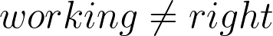
Development is More Art Than Science
Development is more art than science especially when it comes to things like:
Usability
Readability
Maintainability
Reusability
Scalability
Reliability
Security
Everything we do has consequences and knowing how to pick which ones is a true art form that takes knowledge and skill
Remember that Working does not equal Right

Slide 11
What Does it Mean To Be Right? Assuming Already Meet Requirements
Is it reusable?
Does it follow industry best practices?
Is it abstract enough?
Is it efficient/performant?
-ilities
Usability
Maintainability
Readability
Scalability
Portability
Availability
Extensibility
Security
Reusability

Slide 12
Exercise 1: Craftsmanship

Slide 13
Exercise 1: Craftmanship
Goal: Review and discuss code for exercise one and make notes on possible improvements. Think about quality and slow down to ask “Why are we doing it this way?".
Start: A single MVC project in a solution with somewhat convoluted code. It should be something someone implemented an MVP on in a relaxed/easy as possible manner.
End: Code doesn't change. Come up with a list of possible refactorings or improvements to implement.
Starting Points:
Look through the code base for Exercise 1. What can you tell about it?
What can you tell about its author(s) and their intent?

Slide 14
Purist vs Pragmatist
pur· ist: a person who insists on absolute adherence to traditional rules or structures, especially in language or style.
prag· ma· tist: a person who is guided more by practical considerations than by ideals.
I’m am more of a pragmatist in that, I do that in the most correct way possible, whilst still getting things done on time
Strict adherence to purist thinking can be very limiting and make things take way longer than they need to
We’ll see some examples of this in the code
Notes:
pur· ist – Google define
prag· ma· tist – Google define

Slide 15
Architecture
Creating software is actually very easy and you have probably been overthinking it for years.
We’re going to show you a new way to think about applications.
Remember “everything is hard before its easy”, so the patterns might be hard at first, but become very simple once you learn and start applying them.

Slide 16
Complex vs. Complicated
sim· plic· i· ty: the quality or condition of being easy to understand or do.
el· e· gant: pleasingly graceful and stylish in appearance or manner.
com· plex: consisting of many different and connected parts
com· pli· cat· ed: difficult to analyze, understand, or explain
Complexity is always built from simplicity
You must strive for quality and create applications one piece at a time
Notes:
com· plex - Google define
com· pli· cat· ed - Google define

Slide 17
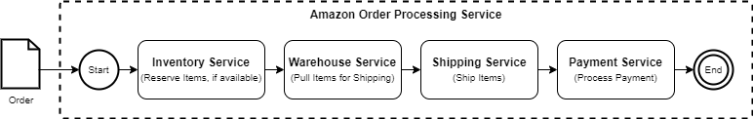
Complex vs. Complicated

Slide 18
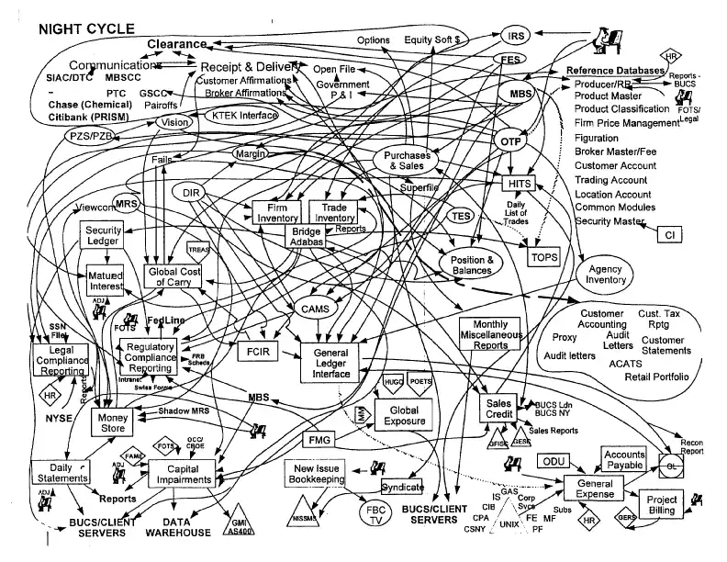

Slide 19
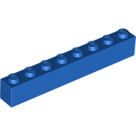
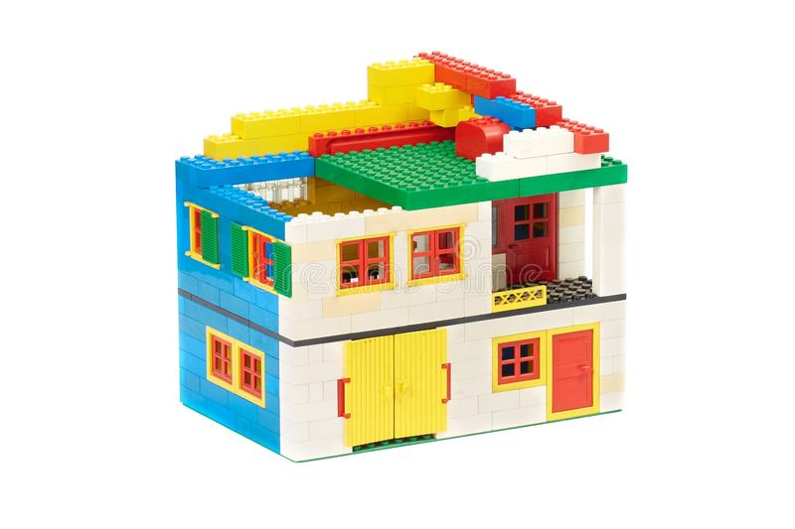
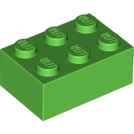
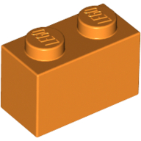
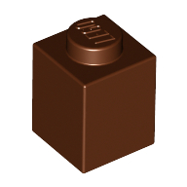
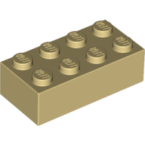
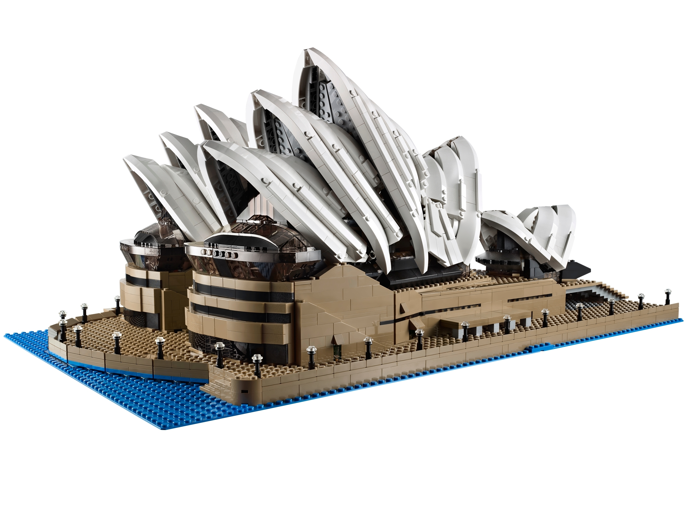
How We Think About Applications
Order Processing Service
Inventory Service
Warehouse Service
Monthly Order Report (Internal)
Shipping Service
Payment Service
eCommerce Store

Slide 20
Fundamental Architectural Pattern
The one we want to focus on is an intra-application architectural pattern called n-Tier Architecture
It’s called n-Tier since it can be as little or many layers as you like. In fact, there is good reason to split the three main layers (presentation, business logic, and data access) into many layers so that your layers don’t violate the Single Responsibility Principle.
Classes would be LEGO bricks, and the n-Tier layers would be the sub-assemblies that we build our structures from

Slide 21
Fundamental Architectural Pattern (C#)
AmazonOrderProcessing.sln
Service.csproj
Domain.csproj
Domain.Tests.csproj
Infrastructure.csproj
Infrastructure.Tests.csproj
Presentation (Service.csproj): web service responsibilities should only be a call pass-through to the business logic layer.
Business Logic (Domain.csproj): all business logic including contracts (POCOs), interfaces, implementations, etc.
Data Access (Infrastructure.csproj): is the only layer that is allowed to talk to external resources such as database and other services. If you are doing both, separate these into different layers.

Slide 22
Exercise 2: Architecture

Slide 23
Exercise 2: Architecture
Goal: Go over code and implement architectural and craftsmanship improvements to the solution.
Start: Same starting point as Exercise 1.
End: Implemented architectural and craftsmanship practices into the code. Focus on one or two big architectural patterns to ensure time, but otherwise dive into more if time allows.
Starting Points:
Can we implement any patterns to simplify the code?
Can we create or move projects around to increase readability and reusability?

Slide 24
Testing
In order to create unit and integration tests, your code must first be testable, therefore good application architecture and class design are essential.
Test Driven Development (TDD): is a process of creating test cases for business requirements before you have the code fully developed. The simplest way of implementing TDD is a process known as Red, Green, Refactor. Write a test for code that fails, write the code to make the test pass, then refactor the code.
If you are new to testing start with TDD, then later you can switch to Test Eventual Development (TED) because you know how to write code that is testable.

Slide 25
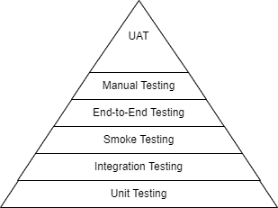
Testing
The most important part of the entire testing pyramid is the unit test (tests a single method/unit of work).
Unit tests should test the happy path and any known un-happy paths.
Good unit tests help ensure all integration tests will succeed.
Unit and integration testing is critically important for refactoring, since you know the code works once done.
Quality is everyone’s responsibility, and certain things can only be tested in code.

Slide 26
Testable Code
A good rule of thumb for writing testable code is trying to follow the SOLID design principles.
Example: SRP – Single Responsibility Principle ensures that your classes do handle one responsibility. This can be seen a the “unit of work” that our unit tests verify.

Slide 27
Unit Testing Methods
Fakes
Mocks
Create a false implementation of supporting interfaces.
Involves manually implementing or automatically stubbing out your interfaces within your tests.
Allows for ultimate flexibility in implementation of support classes.
Create a mock implementation of supporting interfaces.
Typically involves a testing/mocking framework to easily create and verify mocks.
Allows for tailoring the mocked object and verifying that actions have been taken against it.

Slide 28
Why Should I Bother Writing Tests?
Ensures future additions to the codebase do not cause regressions.
Ensures refactorings of the codebase do not cause regressions.
Ensures any amount of touching the codebase do not cause regressions.
Point is: we use unit tests to automatically ensure we do not introduce issues in our work.

Slide 29
Break Time

Slide 30
Exercise 3: Unit Testing

Slide 31
Exercise 3: Unit Testing
Goal: Using our architectural improvements made in Exercise 2, start to implement unit tests for our classes. Implement minor changes to increase testability if possible.
Start: Your output from Exercise 2, or use the Exercise 2 answer key.
End: A class that was otherwise untested or had issues that weren't caught in unit tests should now have relatively complete unit tests.
Starting Points:
What classes are most important to test? How can we test them?
Are there any improvements we can make to the existing implementations to allow them to be tested more easily or correctly?

Slide 32
Refactoring
refactor: restructure (the source code of an application or piece of software) so as to improve operation without altering functionality
We all know about technical debt and how expensive it can be if we don’t pay it down. Refactoring is one way to solve this.

Slide 33
Refactoring
The most important thing to know is that: the less code you write, the less chance you have of screwing something up. So always strive to have the least code as possible.
Refactoring and testing is what allows us to adapt to changing business requirements quickly, because everything has its place.

Slide 34
Reusability
If we follow all lessons that we learned up to this point (craftmanship, proper application architecture, testing, and refactoring) then we should have code that we can reuse in other applications, and we know it will just work (because its tested), and when it doesn’t, we improve the associated code and all applications benefit.
Reusability eases the development process, because we can start new application with known good working code. This saves a lot of time and allows us to create new applications very quickly. This is how you become a rockstar on the team, because you can turn things around very quickly.

Slide 35
Reusability
Reusable and testable code is code where you put in the work to make sure they can’t get into a bad state.
As they say in the Army “the more you sweat in training, the less you bleed in battle.”
If you spend the time and build a component the correct way once, wrap tests around it, and turn it into a reusable package, then the effort spent will save 100-fold the time on future projects.

Slide 36
Exercise 4: Refactoring and Reusability

Slide 37
Exercise 4: Refactoring and Reusability
Goal: Review our code and determine what can be refactored to improve code quality. Use our unit tests to ensure our refactored code still accomplishes what we need without breaking our codebase.
Start: Your output from Exercise 3, or use the Exercise 3 answer key.
End: A codebase with improved quality due to refactorings with the security of our unit tests to ensure we do not introduce regressions.
Starting Points:
What architectural improvements could still be made, if any?
Are there any classes that could be split into others, to enable more focused testing and adherence to SRP?
Furthermore, Is there any code that is repeated which might be possible to abstract into other classes?

Slide 38
Agility
ag· ile: able to move quickly and easily
You cannot do Agile with agility
You need good architecture, unit and integration testing, and reusability in order to truly be agile
If you are always in a move fast mentality you won’t take the time to stop and do things the correct way, and in turn you will end up taking way or time during creation, maintenance, and support.
Take your time and do things the correct way and then reuse it
It will take time to build up a library of reusable code, but once you have it, you will be surprised how quick you can throw together a production quality app

Slide 39
Industry Best Practices
Use design patterns
Use the following principles: Clean Code, SOLID, DRY, YAGNI
Strive to make as much code reusable as possible and make it easily accessible (in NuGet feed, jar, wheel, gem, etc.)
Use logging and do so sparingly
Use a tool like ReSharper and take its recommendations unless they inhibit readability or understandability
Understand problems outside of context, then put the solution back in the context. This applies to new or unknown things.
Say your web app needs to add new OCR functionality, that you haven’t used before. Create a simple console app (throw away applications) or LINQPad script to learn the library, and how to use it. Then refactor the code into something that is reusable, create a NuGet package for it, then use the package in your application. Now you have something that works, and you aren’t wasting time waiting for the web app to start while you are learning the library.
Look at the source code for your favorite libraries and steal things that you like. “good artists copy; great artists steal” – Pablo Picasso
DRY: Once you write or copy the same code more than twice, turn it into a package and reuse it.

Slide 40
Pro Tips
Focus on doing things the right way, even if it adds a little more time.
Doing things right means things will fall into line.
Don’t care about performance until it becomes an issue.
Try never to be clever and prefer explicit over implicit.
Always refactor as you go along.

Slide 41
Pro Tips
Don’t care about performance until it becomes an issue. I first aim to do things correct and most of the time I don’t have performance issues, and when I do, they are easily isolated, so I can detect, test, and fix them, without breaking anything else.
Be Consistent.
Most of the time it is more important to be consistent then it is to always be doings things correctly. Otherwise, it is hard for others since they must work with several different patterns. You can always refactor all the code into the correct pattern
Follow patterns already established in the code or refactor, even if 10+ years old (issues trying to mix old and new without proper refactoring)
Never write apps larger than what you can completely rewrite within a week. This is very important for refactoring. You need to be able to completely refactor the application within a day or two in order to accommodate new requirements. I try never to make it larger than what I can do within a single day. This way I can keep things correct more often.
Try not to be clever, prefer explicit over implicit. If you look at my code, it is so easy to read and follow that even someone that knows nothing about software can read it and understand what it is doing.
Do the right thing, even if it adds a little bit more time (I can't even begin to tell you how many times this has saved me and made my life easier). It is easier to ask for forgiveness than permission.

Slide 42
More Pro Tips
I prefer Fakes to Mocks, since I have seen a lot of time people end up mocking out the code then are trying to test, instead of just dependencies. Also, a lot of time creating Fakes means you have alternative interface implementations that you can reuse for other things, which you can’t do with mocks.
Refactoring
Never turn one-time use code into production code, without refactoring to a correct state
Always refactor as things are changing to keep the code in the best shape possible (sometimes this means rewriting the entire application).

Slide 43
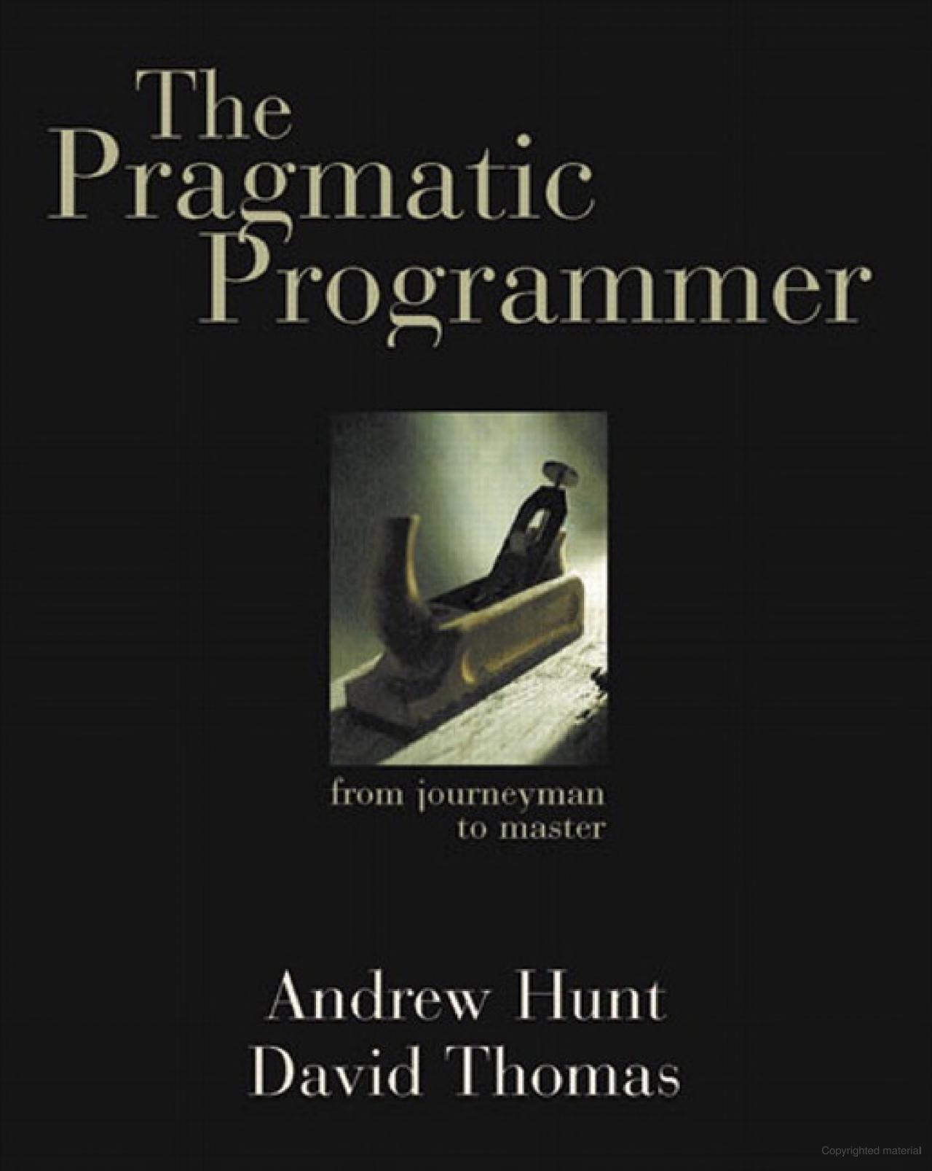
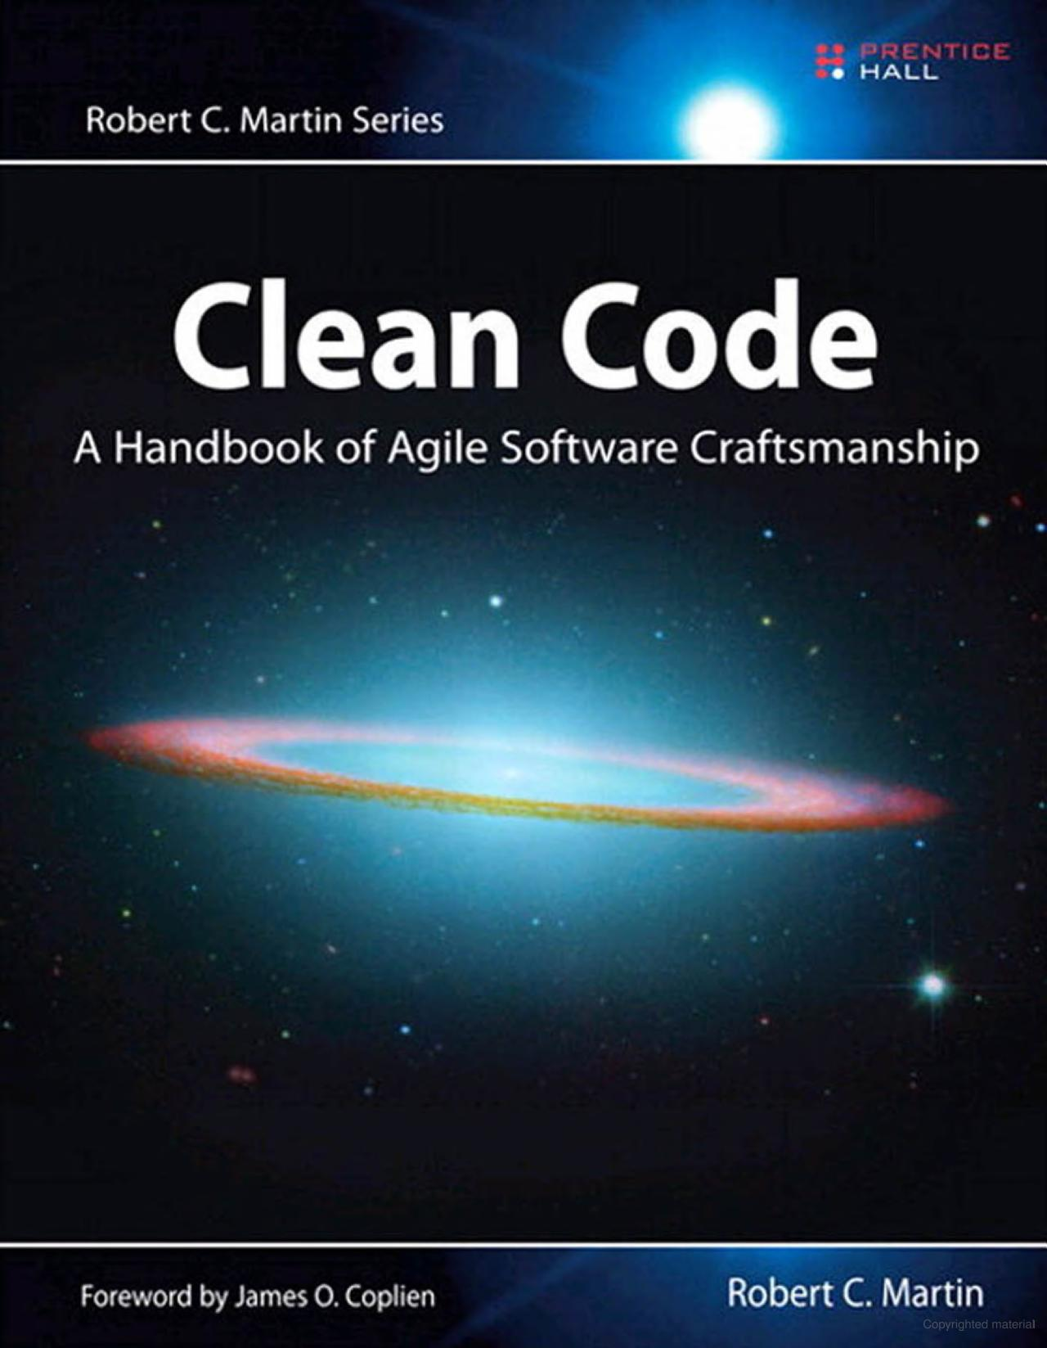
Where to Next?
Read The Pragmatic Programmer and Clean Code.
Try Code Katas
https://github.com/asierba/Katas.CSharp
https://projecteuler.net/archives
Start creating your own reusable packages and setup a feed to consume them from.
Provide us any feedback on the workshop using the Cvent app!
Questions???
github.com/korz github.com/ijwu
@bkorzynski hmfarran@gmail.com

